Slide 1
Your Next Patient – supporting the management of risk

Slide 2
Background
Current Situation
  In recent months Category 2 (conditions, such as stroke or chest pain) response time have significantly increased nationally as a result off increased prolonged handover delays at the secondary care interface, with significant risk held in the community
  Deaths within the community have increased nationally, it is believed there is a link to this and the significant increase in the response times within the emergency departments across the UK
  UHNM is one of 12 Trusts (5 of which are in the Midlands) have been identified as responsible for approximately one third of the total number of patients that are held outside of emergency departments - UHNM holds about
North Bristol Model
  North Bristol NHS Trust has recently piloted the regular mandated moving of patients through their clinical pathways each hour of the day and night regardless of staffing or capacity, this has identified that under almost all circumstances, risk to patients in the community is greater than that to patients in the acute Trust
  This model has been shown to dramatically improve patients safety in the community & change habits
Local Adaptation
  Recognising local circumstances UHNM have chosen to trial an interpretation of this model which moves patients, in response to risk currently during the day time only
  This has been supported by system wide risk assessments in order to improve patient safety throughout our Trust and in the wider community we serve

Slide 3
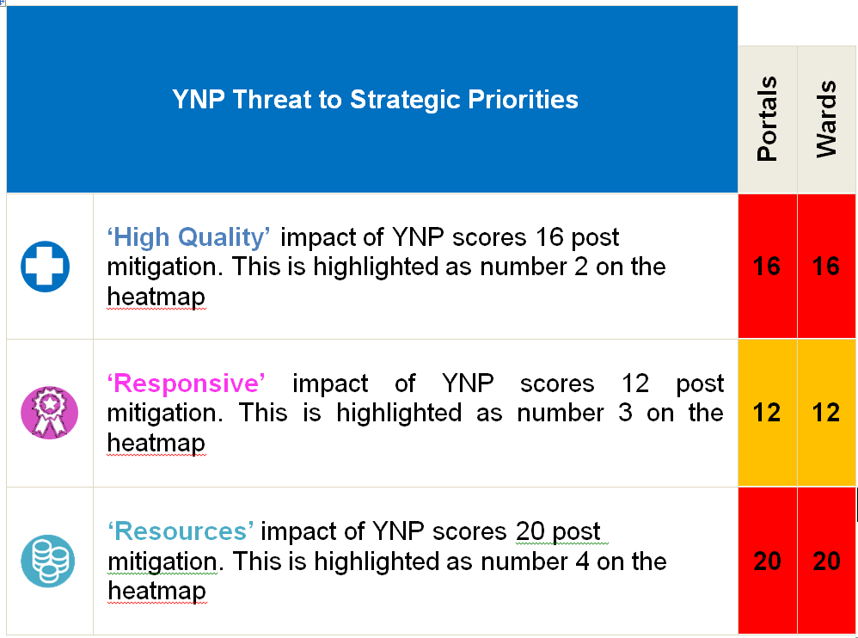
What does the YNP Risk Heat Map tell us?
The YNP Risk Heat Map is designed to identify the level of threat
posed to our Strategic Priorities. It demonstrates the following:
The above risks have been reviewed against the West Midlands Ambulance Service risk number PS-074-V40 ‘Risks associated with extensive Hospital Breaches, Delays and Turnaround times resulting in patient delay and harm, lack of resources to respond and serious incidents’ which is currently scored at 5 (catastrophic) x 5 (almost certain) = total score 25 which is number one on the risk heat map.

Slide 4
Oversight
Ann Marie and her team have identified a space on each ward for a patient to sit or a bed to be placed
These areas will be confirmed over the next 2 days, along with the SOP
The moves ( based on risk) will happen within a 60 minute period to the wards - patients will move based on the triggers and individual ward based teams will be asked to support this in real time
NO patients should be sent back to AMU or ED - mitigation at ward level should be put in place
Ward individual circumstances should be discussed with the Matron – this will not stop the transfer in a timely manner
During next week there will be a daily PDSA meeting , Chaired by Ann Marie and supported by the Exec team
Patients that remain in the additional space at 4 hours should be reviewed by the Matron for the area
Limited to activation in the hours of 08:00 – 18:00
Patients not in a bed space require a plan by 17:30 to be actioned as a priority by 20:30
Patients will not remain outside of a bed space for more than 6 hours
System Plans are also being put in place

Slide 5
SOP - Trial 26th Sept medicine
Trigger
  Full Ambulance Assessment and full Majors with no immediate capacity & risk now to holding ambulances
  CSM to activate YNP SOP following discussion with Deputy COO ( in hours ) Silver ( weekend)
  Each time we activate the YNP a Datix Incident will be completed by the CSM ( one incident per activation)
Portal Actions
  At 7am each morning Portals should have identified fifteen patients for base Wards with all moves within one hour once the policy has been activated
  CSM will notify Porters that rapid deployment of resources is needed w
  Relevant Portals to prepare to accept fifteen patients from ED in the following hour
Ward Actions
  Make ready the risk assessed area to receive a patient
  Enact the YNP plan and prepare to accommodate an additional patient
  Log the patient and their location on the WIS Board as a priority

Slide 6
Any Questions..

