Slide 1
Our Values and
Behaviours Framework

Slide 2
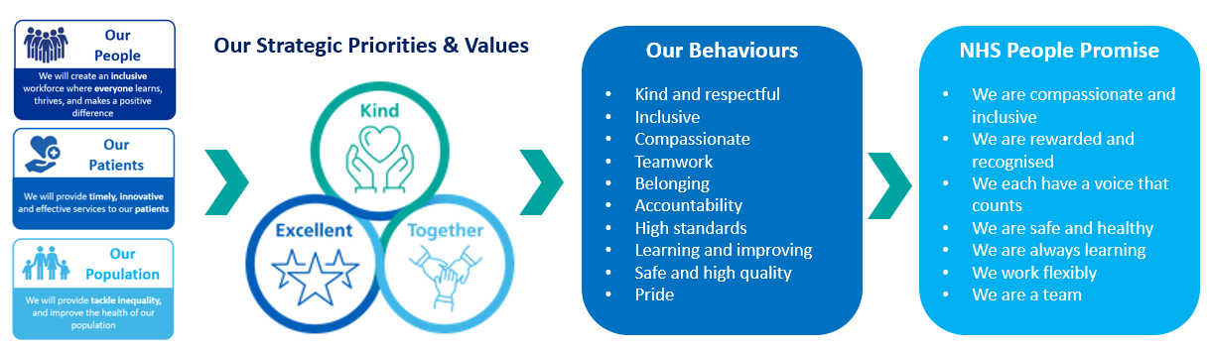
Introduction
We want our Trust to be a compassionate and inclusive workplace where our people know that they are respected and valued. Our behaviour framework outlines the attitudes and behaviours that we expect all colleagues to demonstrate. By doing so, we can all contribute to the success of our organisation and achieve our ambition of delivering the best joined up care for all and making UHNM a great place to work for everyone.
Accountability to these behaviour standards will be part of regular feedback conversations and performance discussions. Where behaviours fall short, we will address them constructively and fairly.

Slide 3



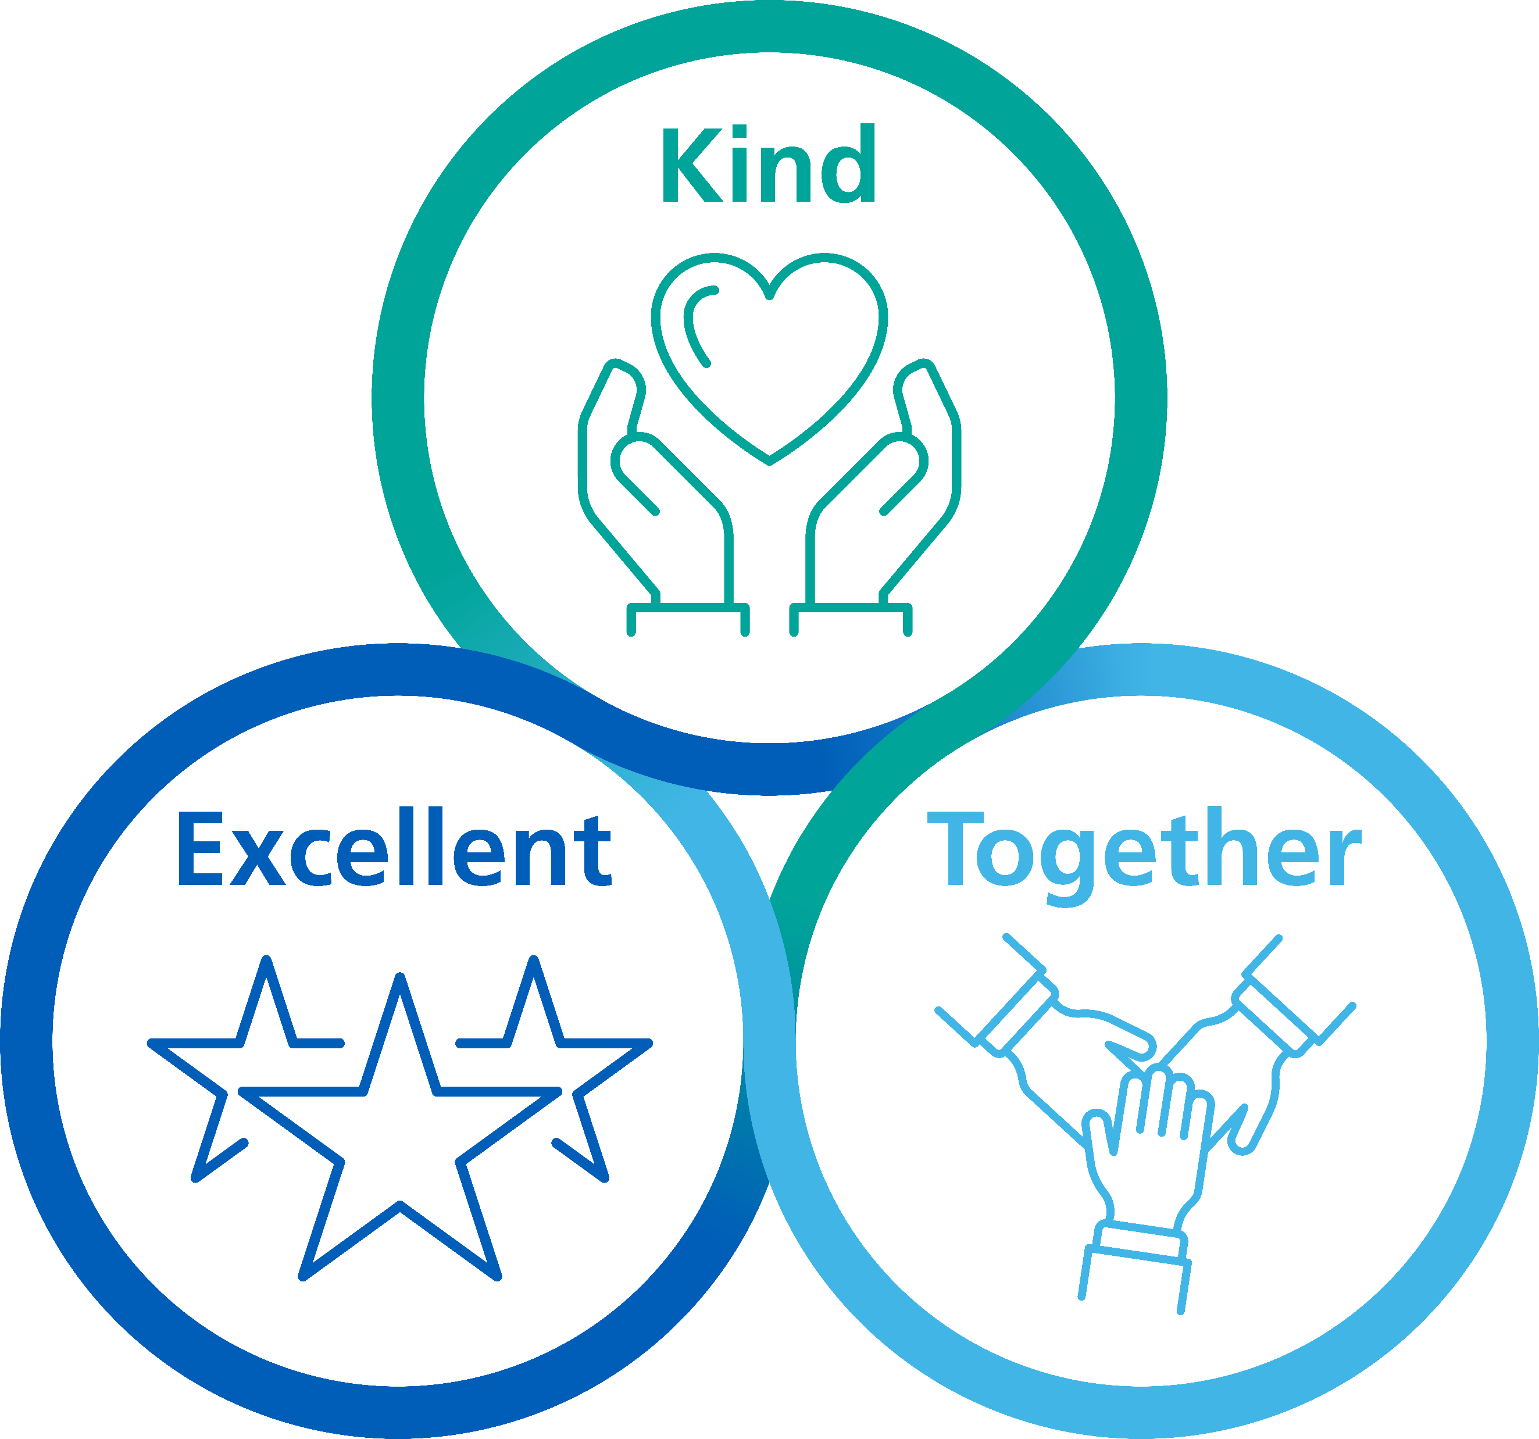
Our Values
 | Kind We believe in treating every individual with compassion and respect. Our actions are guided by empathy, ensuring that our patients, their families and our colleagues feel valued and supported at all times. We prioritise safety by creating a caring environment where everyone feels secure and protected.
 | Excellent We strive for excellence in everything we do. Our dedication to continuous improvement and innovation ensures we provide the best possible care and outcomes for our patients. We are committed to maintaining the highest standards of professionalism and integrity. Patient safety is at the forefront of our pursuit of excellence, with rigorous standards and proactive measures to prevent harm.
 | Together We recognise the strength in unity. By working collaboratively, we harness the diverse skills and perspectives of our team to deliver the highest standards of care. Together, we create a supportive and inclusive environment where everyone can thrive. We are answerable for our actions, behaviour and performance. We are transparent, responsible and we take pride in our work.

Slide 4

I consistently show empathy and understanding by providing compassionate care and support to colleagues, patients and their families. Ensuring they feel safe, valued and heard
I will create a positive and inclusive environment by treating everyone with dignity, respect and trust, fostering a culture of kindness
I demonstrate care and consideration in every interaction, going above and beyond to make others feel valued, included and appreciated
What we expect to see and hear
I treat everyone as a valued individual, and endeavour to ensure that the things I say and do, will not upset others I empathise with others, taking the time to listen, and to understand their perspective I am approachable and polite and acknowledge others with a smile and introduce myself with “hello my name is….” I protect people’s privacy, dignity and confidentiality I go out of my way to make sure people feel welcome and valued I celebrate everyone’s successes and achievements and encourage others to do the same I create an environment where help is happily offered, asked for and provided I promote healthy behaviours at work, and I am respectful of colleagues' wellbeing needs I recognise when support is needed for myself or others and take positive action to signpost to or access the wellbeing resources available I value and champion diversity in our patients and colleagues I give respectful feedback when I see or receive behaviour not in keeping with trust values
What we don’t expect to see and hear
I use discriminatory language – racist, homophobic, transphobic, disablism, religious abuse or other derogatory speech and banter I am impolite, rude or aggressive (physically, verbally or sexually) to colleagues, visitors or patients I undermine and criticise others I lack insight into the diversity of others and the challenges that they may face I stereotype people based on their personal characteristics I exclude others based on difference I make little or no attempt to understand patients or colleagues’ individual needs, preferring to treat them all the same way I display unsustainable or unhealthy working behaviours I neither notice or celebrate success, achievement or effort of others I lack compassion and empathy for others who may be experiencing a difficult time

Slide 5

I consistently uphold the highest standards by demonstrating professionalism, integrity, honesty and a commitment to delivering outstanding care
I seek opportunities to continuously learn and improve to deliver timely, innovative and effective care
I prioritise quality and safety in everything I do to create a safe, effective and caring environment for patients and colleagues
What we expect to see and hear
I always seek to do the right thing and complete my duties to the highest standard following policy and best practice I understand and comply with my professional code of conduct (where this applies) I am always willing to learn, receive feedback and look for better ways to do things I am honest about my mistakes and use them as a learning opportunity I speak up to prevent harm, improve practice and share learning I always protect patient’s dignity and feelings, and support them to make informed choices about their care I create an environment where feedback is encouraged and acted upon, ensuring everyone has a voice I take a positive approach to problem solving and take steps to resolve them or seek support if I’m unable to resolve them myself I take pride in my appearance, my work environment and our organisation I maintain a professional presence on social media I actively participate in appraisal conversations
What we don’t expect to see and hear
I do not consider how my role impacts others or recognise how I can contribute positively I do not value feedback and fail to act when this is provided I make harmful comments about the organisation or colleagues within it I have a negative attitude towards my workplace whilst not putting forward ideas for improvement I do not welcome the suggestions of others if they are not the same as my own I ignore hazards and concerns in my workplace, assuming others will action them I am dismissive of concerns or feedback from colleagues, patients or their families I repeat the same mistakes and do not see them as opportunities for learning

Slide 6

I promote a collaborative, supportive and open culture that fosters a sense of teamwork, delivering a shared purpose
I will create a sense of belonging through an inclusive and welcoming environment, ensuring everyone feels valued, heard, and is welcoming of different perspectives and feedback
I will take responsibility and lead by example, building trust through openness, accountability, and mutual respect
What we expect to see and hear
I appreciate that successful teams are made up of different personalities, perspectives and backgrounds and I value the benefits this brings I get to know people and involve them in decisions I am curious to hear other people’s views and encourage their contributions I recognise and appreciate the efforts of others I demonstrate an approachable, positive and optimistic attitude I persevere in the face of setbacks I speak up against racism, discrimination, bullying and abuse and encourage others to do the same I recognise my biases and actively work to overcome them I ensure that I keep people informed using clear, open and honest communication, and in a way that they can understand I take pride in representing my organisation, my team and my profession
What we don’t expect to see and hear
I exclude, isolate or ostracise others, or only involve people in my ‘in group’ I ignore other peoples requests to be involved I micromanage others I give mixed messages or withhold information I am dismissive of other people’s views I ignore valid concerns I do not get to know the individual and treat people all the same I do not involve patients or colleagues in decision making I do not show appreciation for the efforts of others I do not check my biases to ensure that I treat people equitably I do not take responsibility for my behaviour or actions I unfairly blame or criticise others My behaviours come across as unfriendly and unapproachable I see challenge as a criticism I take no action to address incidents relating to safety of patients or colleagues or I repeat my mistakes

Slide 7

Values Recognition
Our values are at the heart of everything we do
Our Values matter to us. They represent the beliefs and guiding principles that shape our behaviour, culture and processes. They provide us with a sense of purpose, direction, and alignment with our vision and promote a positive working environment where our people are recognised and feel valued.
Do you know a colleague that has done something big or small that has made a real difference to our patients, family members, carers, visitors or colleagues that exemplifies our values of Kind, Excellent and Together? Then why not submit a nomination to the Values Recognition Scheme to recognise their efforts.

