Slide 1

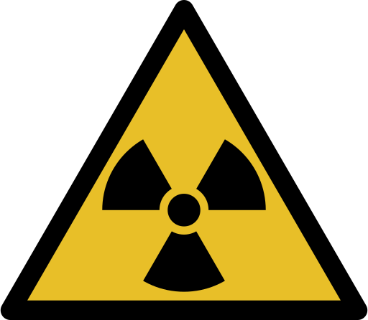
RADIOTHERAPY
CLICK TO ENTER
Click Enable Content!

Slide 2
HOW TO NAVIGATE THROUGH?
This will return you back to the homepage
NEXT PAGE
Will navigate to the next page
BACK
Will navigate back 1 page
Please use the navigation buttons to make your way through the presentation
NEXT PAGE

Slide 3

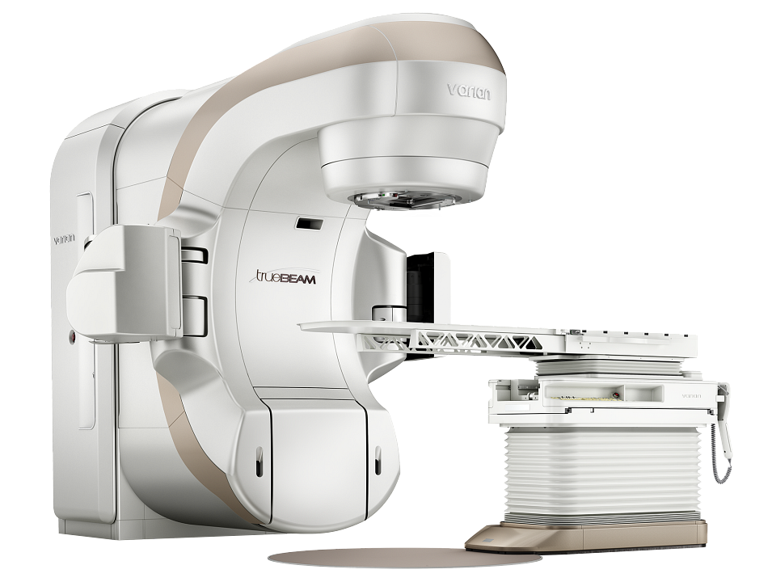
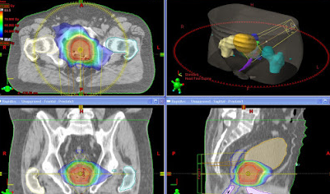
WELCOME TO RADIOTHERAPY - HOMEPAGE
Introduction to Therapeutic Radiography?
What is Radiation and how do we use it?
What is it like to be a Radiographer?
How to become a Radiographer
Career Resources
University vs Apprenticeship
Work Experience
Pressing Esc at any time will close the application
Radiotherapy Quiz

Slide 4
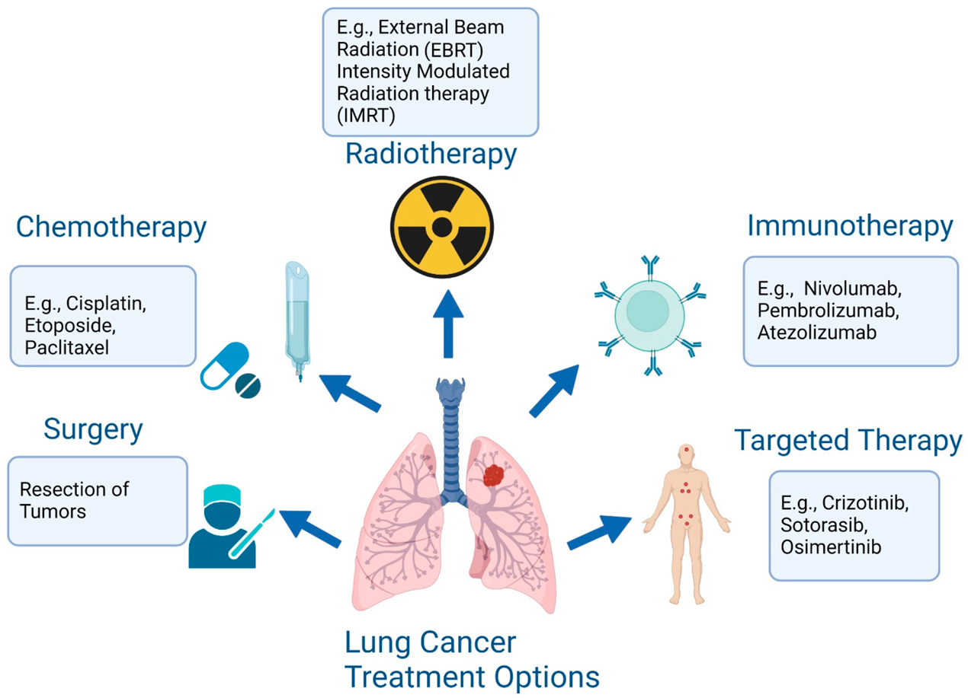
Radiotherapy
Is one of the main treatment possibilities for cancer patients.
Aiming to destroy cancer cells to cure or relieve symptoms.
NEXT PAGE

Slide 5


Radiotherapy
Radiotherapy is prescribed by clinical oncologists and treatment is delivered by therapeutic radiographers.
Clinical Oncologist
The Patient
Assessment
Treatment
Nurses, Dieticians,
and Radiographers
Radiographers
NEXT PAGE
Planning
BACK
Physicists and Radiographers

Slide 6
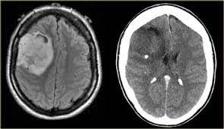
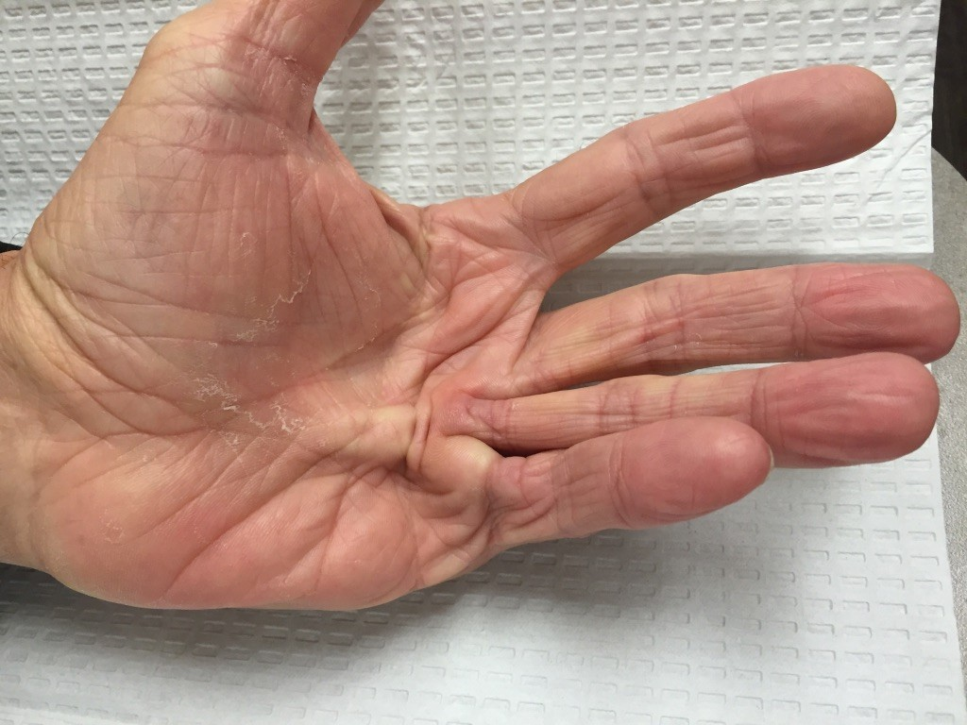
Who we Treat
Patients with tumours that can be treated by Radiotherapy (Radiosensitive).
Over 50% of people with cancer need radiotherapy as part of their treatment plan.
Used to eliminate cancer, reduce the chance of cancer coming back or relieve symptoms caused by cancer.
Dupuytren's contracture
NEXT PAGE
BACK

Slide 7
Types
Radiotherapy
Click to see the different types of radiotherapy
Multiple types of radiotherapy are available that either treat the patient with the radiation being targeted into the patient from an external machine sources of radiation are inserted into the patient and delivered internally.
NEXT PAGE
BACK

Slide 8
Types
MV Linear Accelerators
External
Orthovoltage
Radiotherapy
Internal
Brachytherapy
(LDR and HDR)
Click to see the different types of radiotherapy
Multiple types of radiotherapy are available that either treat the patient with the radiation being targeted into the patient from an external machine sources of radiation are inserted into the patient and delivered internally.
NEXT PAGE
BACK

Slide 9
What We Treat With
MV Photons - Majority
kV Photons – skin
Electrons – Larger Superficial lesions
Brachytherapy - Physical Sources
  (emit gamma-rays)
Patient not
Radioactive
Patient Radioactive
NEXT PAGE
BACK

Slide 10
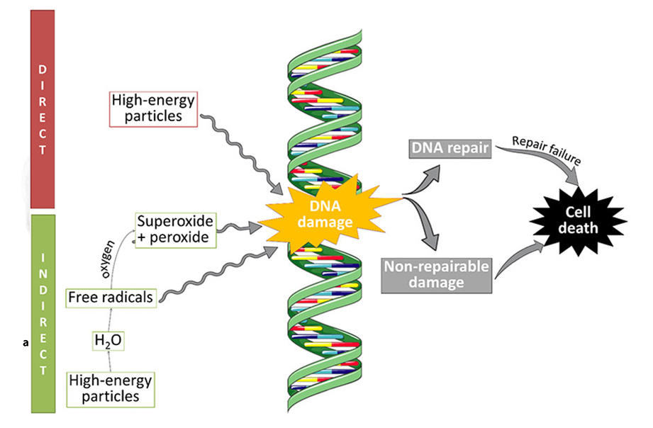
How it works: Action
The high energy particles either directly interact with DNA and cause damage or interact with molecules such as water. This in turn creates free radicals that interact with the DNA causing damage.
This can either be repaired or not causing cell death.
Healthy cells tend to have a better ability to repair DNA damage than cancer cells.
NEXT PAGE
BACK

Slide 11
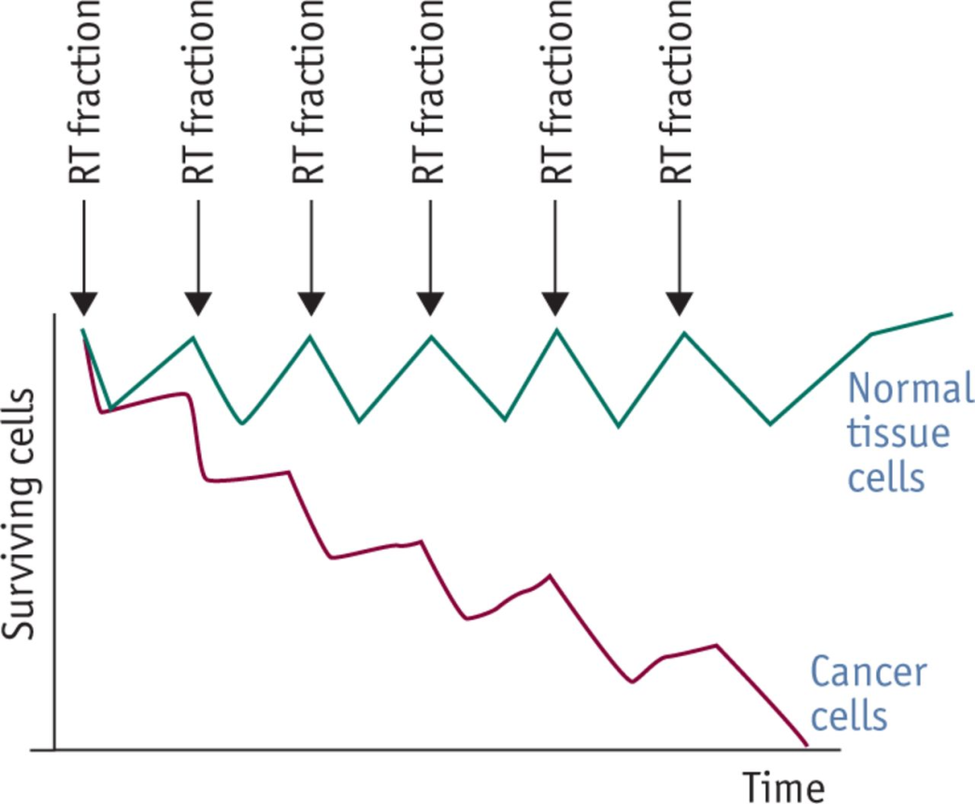
How it works: Fractionation
In most circumstances multiple treatments are given known as fractions.
Each time these are delivered more cells are damaged and die.
In the time between each fraction this allows some normal cells to heal, although some do die which causes side effects.
NEXT PAGE
BACK

Slide 12
Radiotherapy Doses
Dose is limited by tissue tolerance
Affects normal tissue
Critical structures/organs near the tumour
Whether radical, adjuvant or palliative
Fractionation
Higher total doses tend to be given over longer periods of time
Measured in Grays (Gy)
NEXT PAGE
BACK

Slide 13
Pre-Treatment
Mould Room
Dosimetry +
Medical Physics
CT
Before treatment can be delivered the patient must undergo a pre-treatment process.
This involves a CT scan planning by dosimetry and medical physics and potentially a mould room visit for some patients
NEXT PAGE
BACK

Slide 14
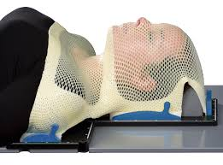
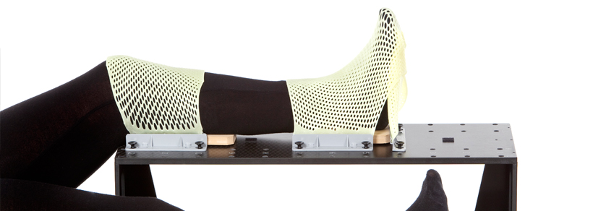
Mould Room
Specialises in the development of immobilisation devices so that radiographers can accurately deliver treatment
NEXT PAGE
BACK

Slide 15
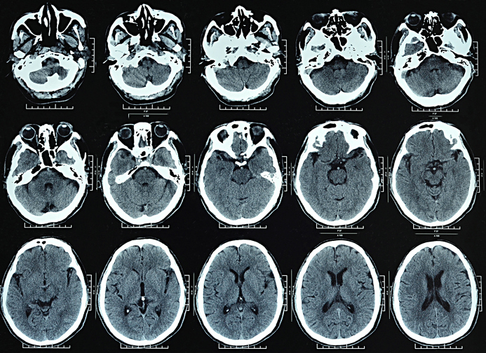
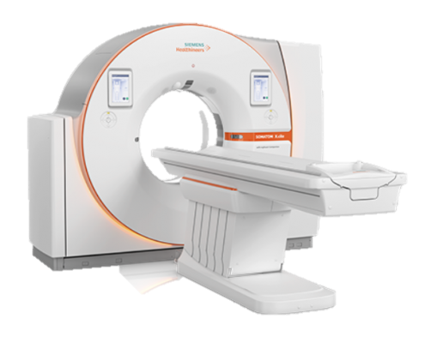
CT
Siemens scanner
This is our patients first experience of the ‘Radiotherapy pathway’
Their setup is very important – how they are scanned is the ‘gold standard’ for the rest of their treatment
Understanding of patients needs is critical
Patients need to know what to expect before undertaking the scan to progress to treatment.
The pre-treatment assessments given at CT explain the entire pathway from start to finish
NEXT PAGE
BACK

Slide 16
Planning / Dosimetry
A team of planning radiographers and clinical technologists plan the patients treatment and get all the plan data ready to transfer to the linear accelerators
Process that involves numerous checks from a planning, consultant and medical physics perspective.
Below are plans of a prostate patient
NEXT PAGE
BACK

Slide 17
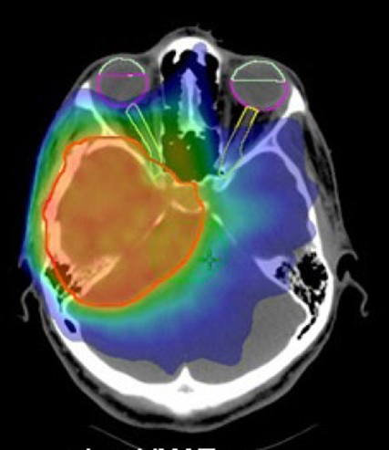
Radiotherapy Planning
The red areas on this section demonstrate the high dose treatment area.
Blue and green are low dose regions outside the area of primary interest.
The optic nerve in this example is mostly green and blue showing how the treatment dose has been tailored to avoid this sensitive structure.
NEXT PAGE
BACK

Slide 18
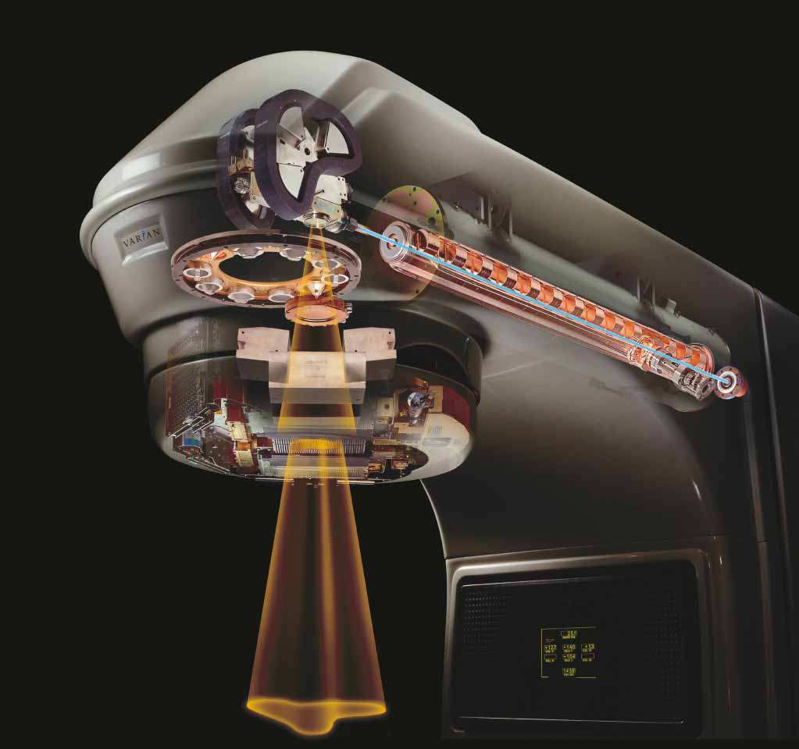
How a Linear Accelerator works
High Energy photons are generated by accelerating electrons along the long tube (wave guide).
Using large magnets they are bent through 90 degrees where they hit a tungsten target.
When they hit the target the electrons transfer all their energy into photons.
The photons come out of the machine in a shape defined by multileaf collimators.
NEXT PAGE
BACK

Slide 19
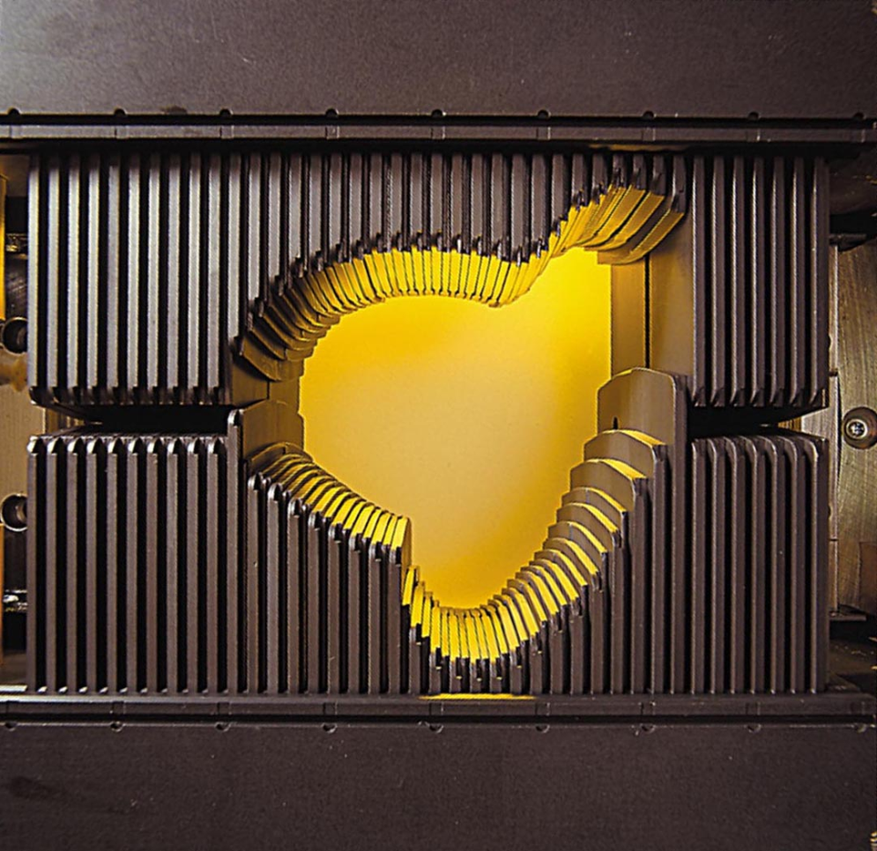

Multileaf Collimators
Multileaf collimators can shape the radiation passing through them to any shape so as to conform to the shape of the tumour.
As the treatment is being delivered each leaf is individually dynamically controlled.
This allows the leaf to move in and out of the treatment field carefully controlling the dose delivered to the patient.
Click play to see mlc shapes move as the treatment machine rotates
NEXT PAGE
BACK

Slide 20
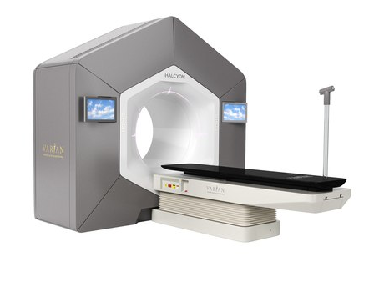
Treatment Machines: Linear Accelerators
In UHNM we use Varian Truebeams and Varian Halcyons as shown above
NEXT PAGE
BACK

Slide 21
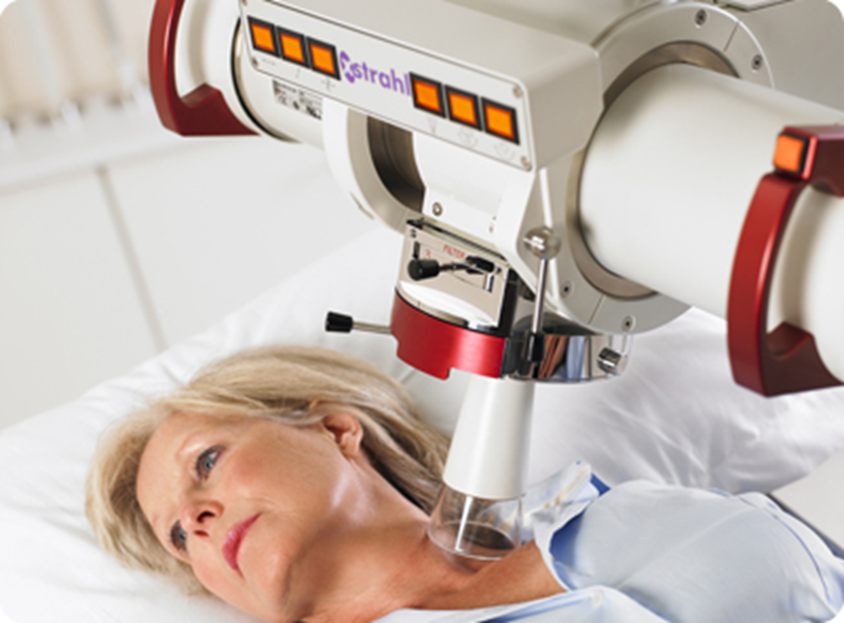
Treatment Machines:
Orthovoltage
NEXT PAGE
Used to treat superficial tumours, generally skin lesions such as basal cell carcinomas.
Uses a lower energy compared to the linear accelerators.
BACK

Slide 22
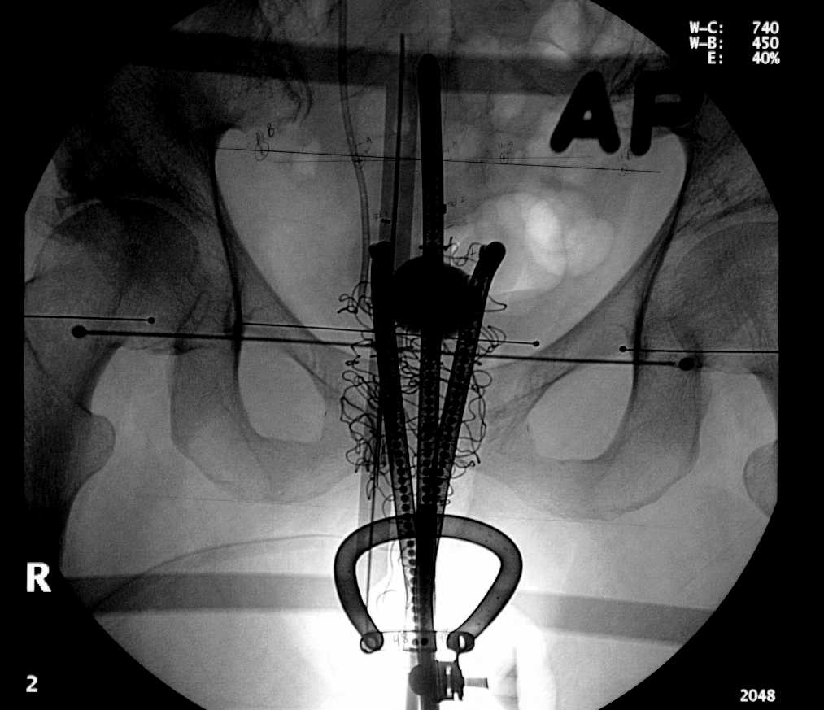
Brachytherapy Treatment
NEXT PAGE
BACK
Xray showing the insertion of the radioactive sources in a brachytherapy patient

Slide 23
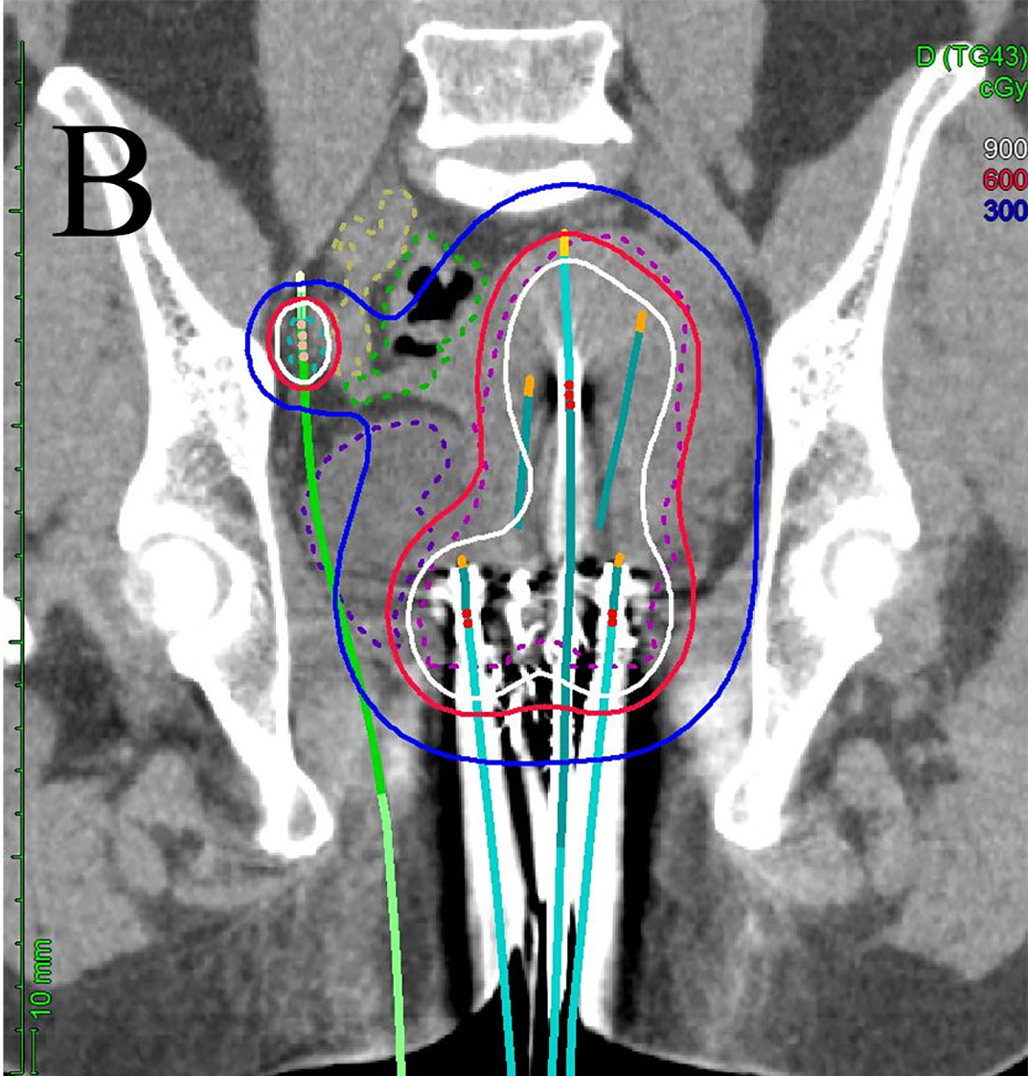
Brachytherapy Treatment
NEXT PAGE
BACK
CT scan slice with the dose surrounding it showing where the dose should fall

Slide 24
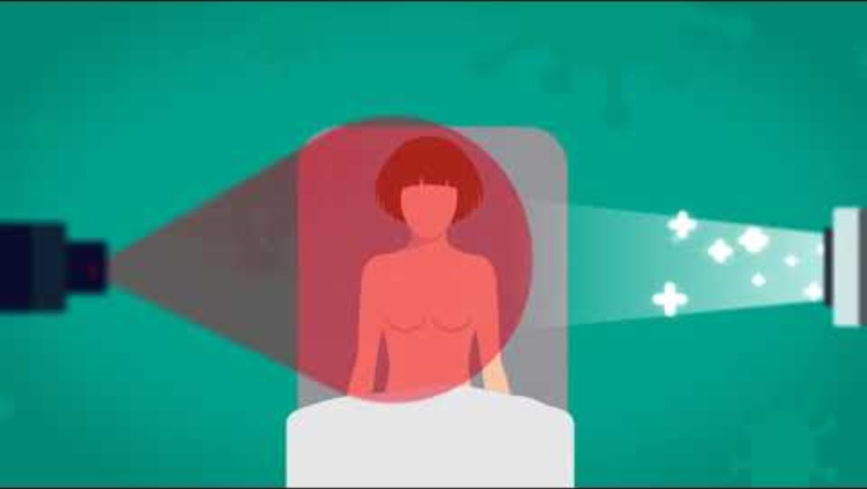
GENESISCARE – RADIOTHERAPY EXPLAINED
BACK

Slide 25
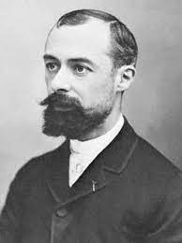
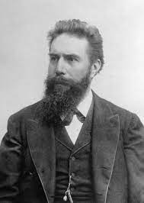
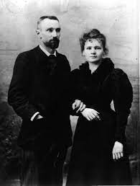
Radiation
Henri Becquerel (Left) discovered radioactivity
Wilhelm Rontgen (middle) discovered X rays in
1895
Marie and Pierre Curie (Right) discover radium
as a radioactive source in 1898.
NEXT PAGE
BACK

Slide 26
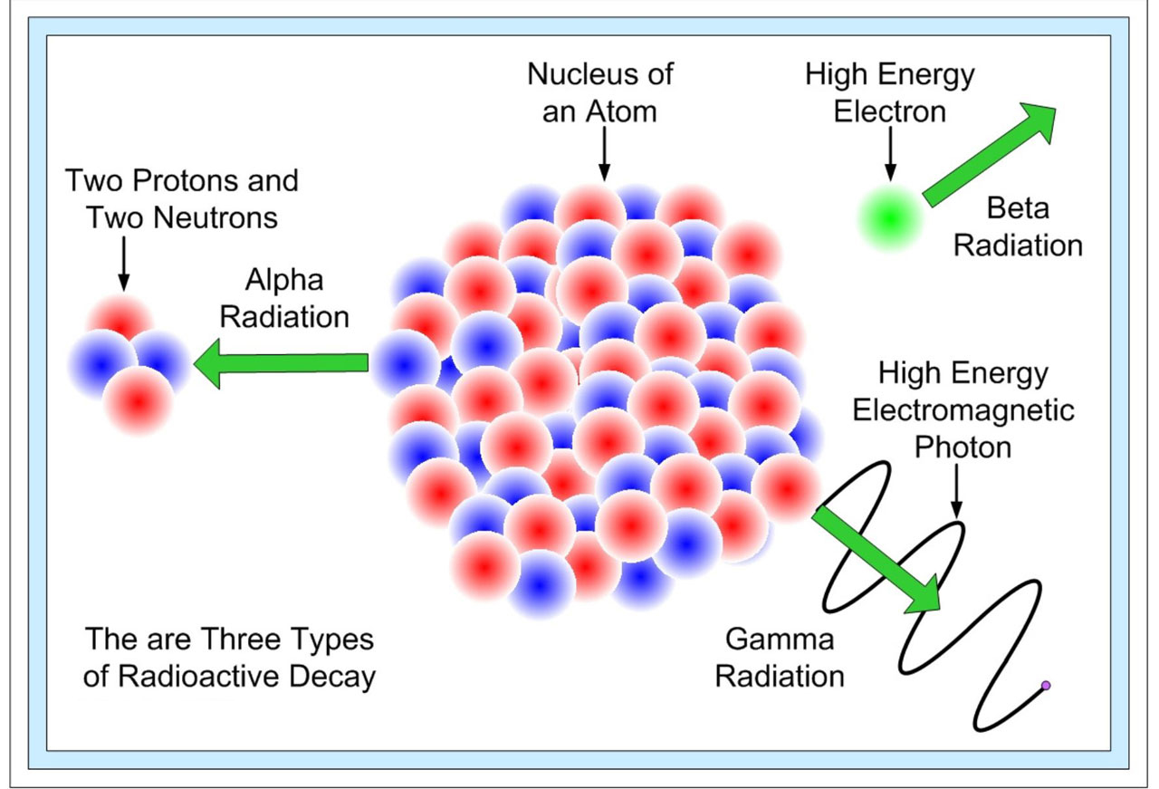
What is radioactivity?
Is the emission of ionizing radiation or particles caused by spontaneous disintegration of atomic nuclei.
NEXT PAGE
BACK

Slide 27





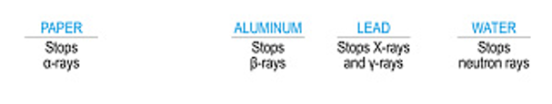
Types of radiation
Click to see how far each ray penetrates
Different types of radiation have different penetrating properties and carry a different amount of energy.
In radiotherapy we use photons to treat. These can be referred to as high energy
x-rays, this term is used for photons because they have been generated from electrons.
Alpha Rays
Beta Rays
X Rays
Gamma Rays
Neutron Rays
NEXT PAGE
BACK

Slide 28
Types of radiation
Click to see how far each ray penetrates
Different types of radiation have different penetrating properties and carry a different amount of energy.
In radiotherapy we use photons to treat. These can be referred to as high energy
x-rays, this term is used for photons because they have been generated from electrons.
Alpha Rays
Beta Rays
X Rays
Gamma Rays
Neutron Rays
NEXT PAGE
BACK

Slide 29
Radiation use: Treatment
We have already alluded to the treatment side of radiotherapy, with photons being the major source of radiation used.
Electrons are also used in some linear accelerators as well as protons, for external beam therapy.
The most common radioactive materials used in brachytherapy include:
  Cesium-131
  Iridium-192
  Iodine-125
  Palladium-103
NEXT PAGE
BACK

Slide 30
Radiation Use: Imaging
Different types of images can be generated from machines including:
  X-rays –2D image
  Cone beam CT scans – 3D volumetric image
  MRI images (These are only present on MRI linear accelerators)
NEXT PAGE
BACK

Slide 31
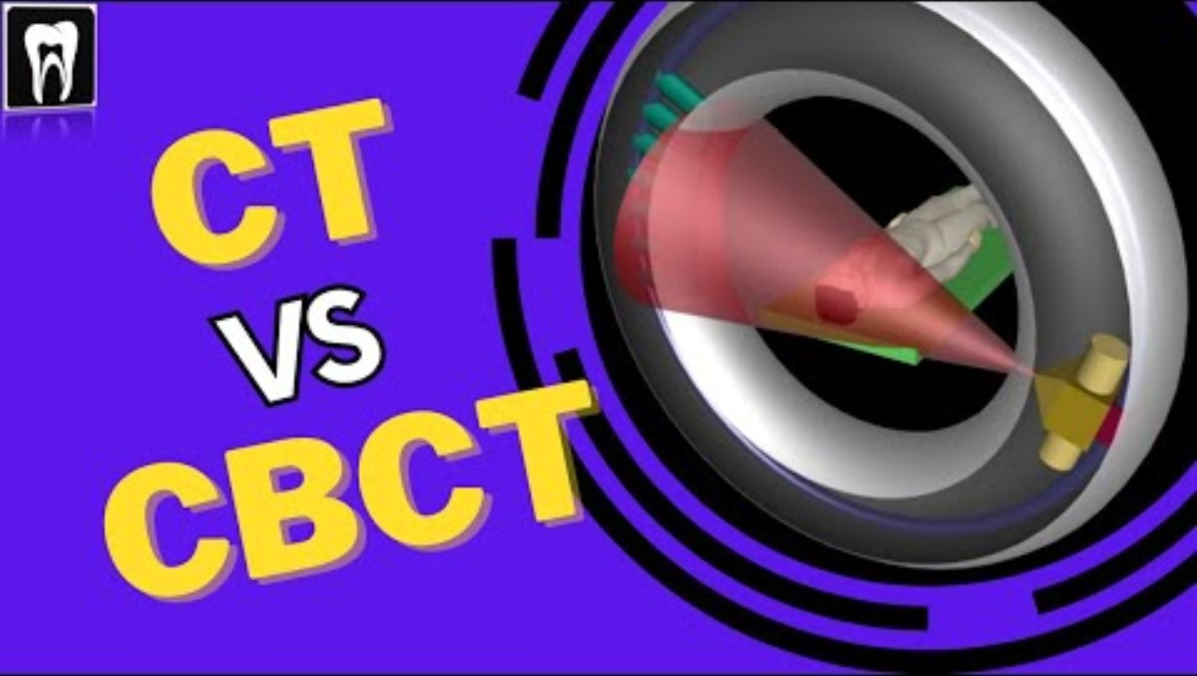
Radiation Use: Imaging
Click to see how a 3D CBCT is created
NEXT PAGE
BACK

Slide 32
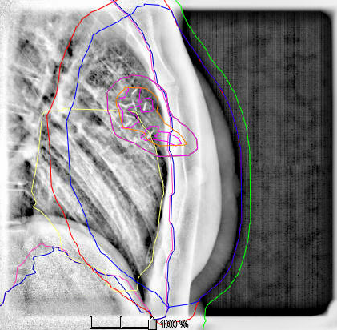
Radiation Use: Imaging
  These images allow us to analyse patient position and make adjustments accordingly to match patient position on the treatment couch with the position they were in at the pre-treatment CT scan.
BACK

Slide 33
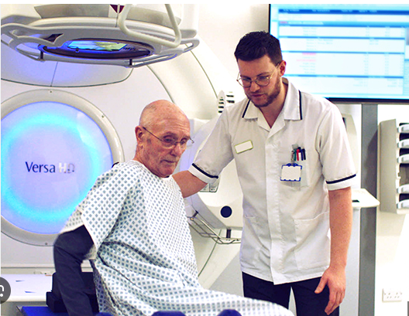
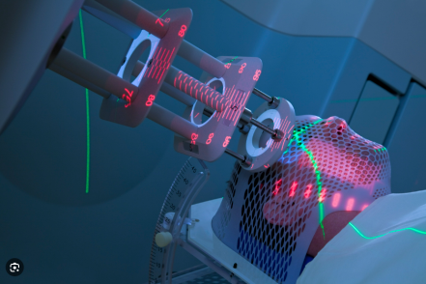
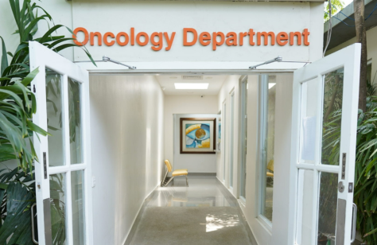
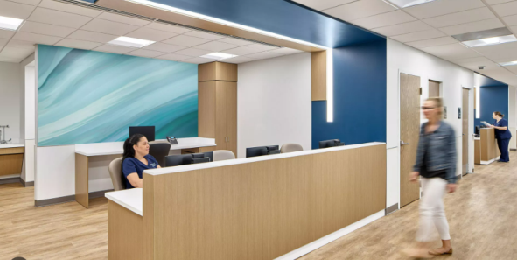
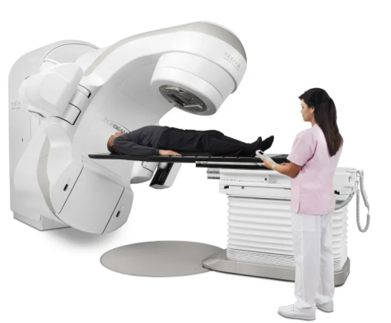

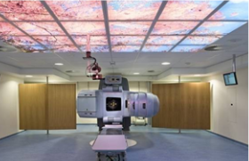
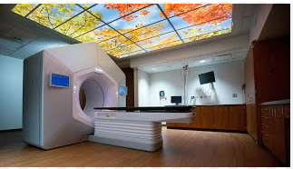
Therapeutic Radiographers
Who are we?
Allied health professionals registered under the Health and Care Professions Council
Where do they work?
In an oncology centre, within a hospital trust.
The centres are an outpatient department, which means patients attend for an appointment from home unless ill and they are transferred from a hospital ward.
Appointments vary in length (12 – 45 mins) depending on treatment technique.
NEXT PAGE
What do we do?
Treat and care for cancer patients using ionising radiation.
BACK
What do we use?
Most commonly use linear accelerators amongst other machines to treat patients

Slide 34
Working life as a Therapeutic Radiographer
Working hours are generally 8.30 - 4.30 Monday – Friday however shifts can cover from 8am to 8pm with a half hour lunch.
An on-call service is provided at weekends and Bank Holidays for emergency oncology patients, this is usually on a rota system.
Newly qualified radiographers usually work in all areas of the department in order to complete competencies and further develop skills, with specialization occurring as you move through the bandings.
NEXT PAGE
BACK

Slide 35
Working life as a Therapeutic Radiographer
Click the times to see what can happen at any time
8am
8.30am
11.00
2.30
4.00
BACK

Slide 36
Working life as a Therapeutic Radiographer
Click the times to see what can happen at any time
8am
8.30am
11.00
2.30
4.00
The team arrives to ensure the linear accelerator is warmed up and has met all its quality assurance requirements.
The machines are complex but are fitted with interlocks for safety.
Look through the list of patients and check if there are any new starters we need to print out appointment times for.
Go over emails and answer where possible or make a to do list for later.
The machines first patient is due to be treated. Walk the patients in from the waiting room and ensure that they have completed the preparation required.
A patient’s anatomy has altered its position and requires a rescan.
Have a conversation with radiotherapy CT staff, dosimetry, the consultant and scheduling to rearrange this and ensure that it is completed in a timely manner to ensure as little disruption to their treatment as possible.
Talk the process through with the patient to ensure they feel comfortable with what is going to happen.
A new patient is due, I go to speak to them and deliver a first day chat. Talking them through the treatment process and what to expect.
Confirming what potential side effects could occur and explaining the support system we have in place with them.
End of the day, it’s time for handover to the late shift.
Documentation must be checked, all journal notes for patients entered and alerts for the next day added.
BACK

Slide 37
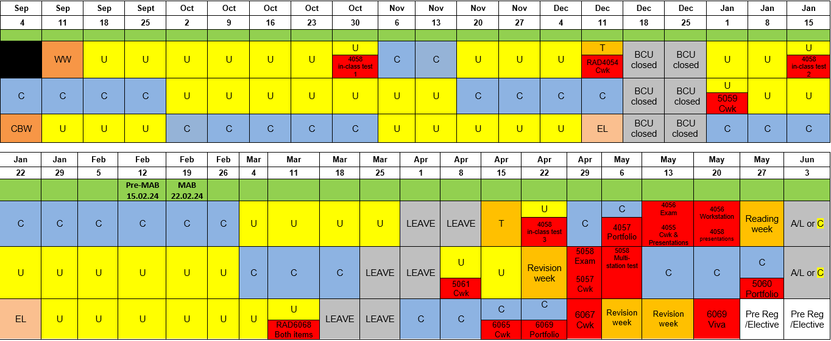
BSc Undergraduate degree
  Most of your time spent learning at university
  Approximately 12 weeks per year in clinical placement
  Gain a Bachelor of Science degree on completion
  Can register with the Health and Care Professions Council as a Therapeutic Radiographer
NEXT PAGE
BACK

Slide 38
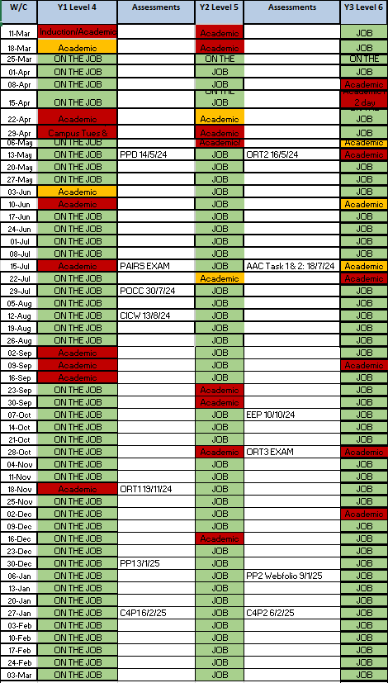
Degree Apprenticeship
  Most time spent at the hospital where you are employed and receive a wage.
  Majority of learning is online with a few weeks or couple of days in a year at university (depending on the university)
  Get 20% of your clinical time as study to do your university work.
  Open to everyone of any age that meets the entry requirements
NEXT PAGE
BACK

Slide 39
Degree Apprenticeship – Entry Requirements
Applicants must:
- be over 18 years of age
- not be in full-time education
- have GSCE maths and English at level 2 or above
- have completed level 3 learning, e.g. A levels, T levels, Access to Higher Education Diploma
- 6 months experience working in a health and social care setting, (may be possible without)
NEXT PAGE
BACK

Slide 40
Postgraduate Programme
Most of the time is spent at university but the course is condensed into two years rather than three.
This is an option for those already with a relevant degree from university, such as psychology or biomedical science, generally science related subjects.
BACK

Slide 41
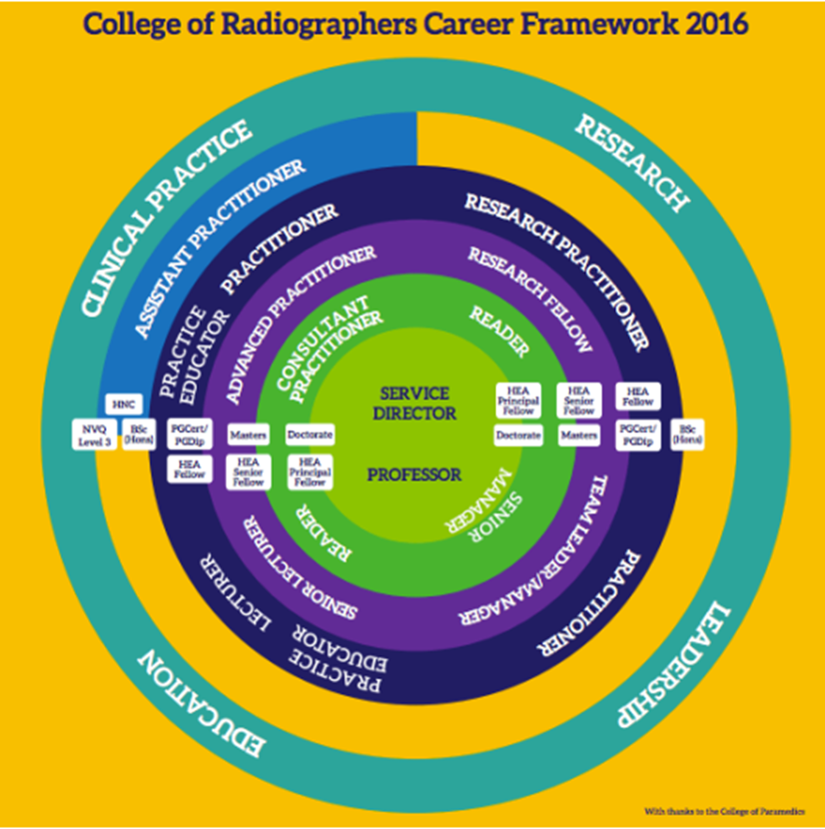
Where Radiotherapy could lead you
There are multiple options for specialization, if you do indeed want to that are generally classified with four areas; research, clinical practice, education and leadership.

Slide 42
Career Resources
Links to SOR - Radiography Careers | CoR (collegeofradiographers.ac.uk
Radiography careers introduction | CoR (collegeofradiographers.ac.uk
HCPC - Radiographers | (hcpc-uk.org
Radiotherapy UK - Radiotherapy UK
RadChat - Rad Chat | All Episodes (transistor.fm
Where can my career lead?
12604-CoR-ECF-Interactive-v9a (sor.org
NEXT PAGE

Slide 43

Universities Offering Radiotherapy
Birmingham City University
Cardiff University
City, University of London
Glasgow Caledonian University
London South Bank University
Queen Margaret University
Sheffield Hallam University
St George’s University of London
Ulster University
University of Hertfordshire
University of Liverpool
University of Suffolk
University of West of England

Slide 44
University vs Apprenticeship
University: https://digital.ucas.com/coursedisplay/results/courses?searchTerm=Therapeutic%20Radiography&studyYear=2024&destination=Undergraduate&postcodeDistanceSystem=imperial&pageNumber=1&sort=MostRelevant&clearingPreference=None
Apprenticeship: Training providers for Therapeutic radiographer (level 6) (education.gov.uk)
Annex 21: https://www.nhsemployers.org/system/files/2021-06/apprenticeships-in-the-nhs.pdf

Slide 45
Work Experience
UHNM work experience page -Work Experience at UHNM

Slide 46
Radiotherapy Quiz
Test your knowledge on what you have learnt
START QUIZ

Slide 47
Radiotherapy Quiz
Question 1
What type of machine do radiographers mainly use to deliver radiotherapy treatment?
A) Linear Accelerator
B) MRI
C) Ultrasound

Slide 48

Radiotherapy Quiz
Well done, Linear Accelerators are the machines that deliver Radiotherapy. Royal Stoke Hospital has 4 treatment machines, 2 TrueBeam and 2 Halcyon treatment machines. They are made by Varian
Continue Quiz

Slide 49

Radiotherapy Quiz
Incorrect,
Have another go
Go back to the question

Slide 50
Radiotherapy Quiz
Question 2
What disease is primary focus of radiotherapy?
A) Arthritis
B) Cancer
C) HIV

Slide 51
Radiotherapy Quiz
Well done, Cancer is the primary focus of Radiotherapy. Radiotherapy can be used as standalone treatment or in conjunction with surgery and chemotherapy
Continue Quiz

Slide 52
Radiotherapy Quiz
Incorrect,
Have another go
Go back to the question

Slide 53
Radiotherapy Quiz
Question 3
What is the name given to the treatment where the patient has radioactive material physically inserted into the body?
A) Brachytherapy
B) External Beam Therapy
C) Immunotherapy

Slide 54
Radiotherapy Quiz
Well done, Brachytherapy is the name of the treatment where the patient has a radioactive material inserted into the body. This procedure is done in a Brachytherapy theatre, which there is in the Royal Stoke Radiotherapy Department
Continue Quiz

Slide 55
Radiotherapy Quiz
Incorrect,
Have another go
Go back to the question

Slide 56
Radiotherapy Quiz
Question 4
Radiation interacts with which part of the cancer cell to cause it to die?
A) Cell membrane
B) Cytoplasm
C) DNA

Slide 57
Radiotherapy Quiz
Well done, damaged caused to DNA can result in cell death. Healthy cells have the ability to repair themselves, where cancer cells die when their DNA is damaged
Continue Quiz

Slide 58
Radiotherapy Quiz
Incorrect,
Have another go
Go back to the question

Slide 59
Radiotherapy Quiz
Question 5
Mould room specializes in doing what for the patients?
A) Planning the treatment
B) Scanning the patient
C) Creating immobilisation devices

Slide 60
Radiotherapy Quiz
Well done, Mouldroom is part of the pre-treatment area. They specialise in making immobilisation equipment to ensure the patient remains still and in the same position. Areas such as Head and Neck region as well as limbs will have appointments with Mouldroom prior to CT scanning
Continue Quiz

Slide 61
Radiotherapy Quiz
Incorrect,
Have another go
Go back to the question

Slide 62
Radiotherapy Quiz
Question 6
What type of particle is primarily used for treatment in radiotherapy?
A) Photons
B) Alpha particles
C) Beta particles

Slide 63
Radiotherapy Quiz
Well done, Photons are created by the treatment machine for Radiotherapy.
Continue Quiz

Slide 64
Radiotherapy Quiz
Incorrect,
Have another go
Go back to the question

Slide 65
Radiotherapy Quiz
Question 7
Multi-leaf collimators are used to do what?
Position the patient
B) Shape the radiation beam
C) Sterilize the treatment area

Slide 66
Radiotherapy Quiz
Well done, MLC’s shape the radiation beam. It can also vary the intentsity of the radiation beam as the treatment gantry moves around the patient. This is for IMRT and VMAT treatments
Continue Quiz

Slide 67
Radiotherapy Quiz
Incorrect,
Have another go
Go back to the question

Slide 68
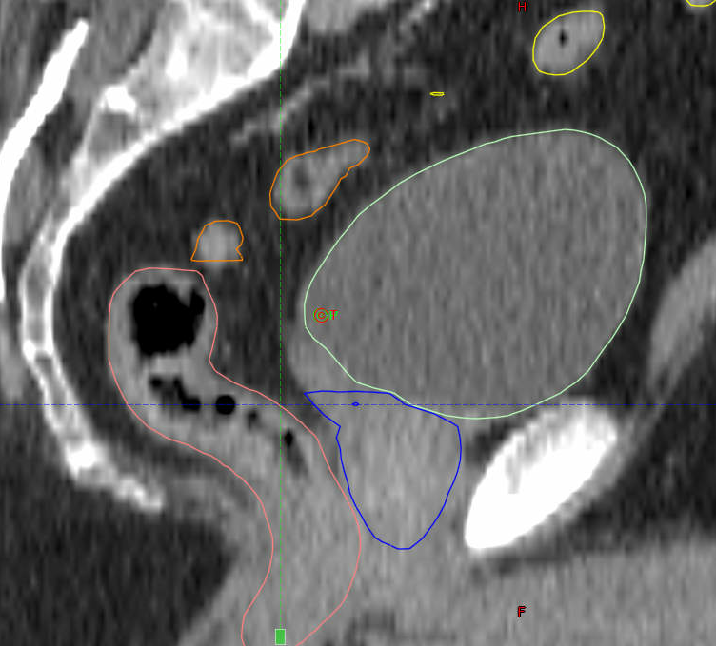




Radiotherapy Quiz
Question 8
Can you identify the correct anatomy?
A) A-bladder, B-rectum, C-bowel, D-prostate
B) A-rectum, B-prostate, C-bladder, D-bowel
C) A-bladder, B-prostate, C-rectum, D-bowel
C) A-Bowel, B-bladder, C-prostate, D-rectum

Slide 69
Radiotherapy Quiz
Well done, the bladder sits on top and front of the prostate and the rectum is behind the prostate. This is the reason why Prostate patients are likely to do preparation for Radiotherapy treatment
Continue Quiz

Slide 70
Radiotherapy Quiz
Incorrect,
Have another go
Go back to the question

Slide 71
Radiotherapy Quiz
Question 9
Which routes can get you into a radiotherapy career?
A) Undergraduate degree
B) Apprenticeship
C) Postgraduate degree
D) All of the above

Slide 72
Radiotherapy Quiz
Well done, in fact all three options can get you into a Radiotherapy career
Continue Quiz

Slide 73
Radiotherapy Quiz
Incorrect,
Have another go
Go back to the question

Slide 74
Radiotherapy Quiz
Question 10
What are Radiographers classed as?
A) Midwife
B) Allied Health Professionals
C) Clinical Scientist

Slide 75
Radiotherapy Quiz
Well done, Radiographers are Allied Health Professionals
Continue Quiz

Slide 76
Radiotherapy Quiz
Incorrect,
Have another go
Go back to the question

Slide 77

Radiotherapy Quiz
Congratulations you have completed the quiz.
In many Radiotherapy and Chemotherapy departments patients will ring the bell to signify that they have finished treatment
Click the icon to return to the Homepage

